Slide 1
BOC 1003 Supplemental Slides
Luminaire Level Lighting Controls
Notes:
Supplemental slides Luminaire Level Lighting Controls

Slide 2
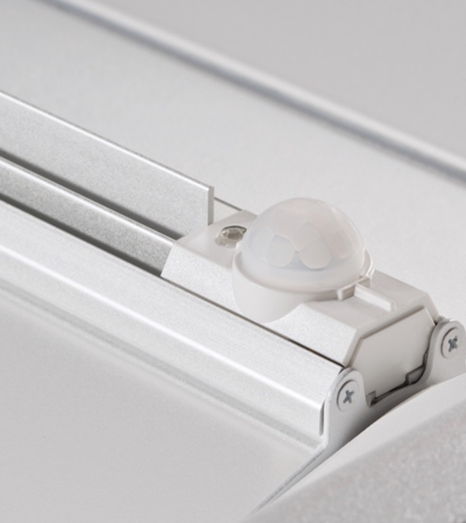
Luminaire Level Lighting Controls (LLLC)
LLLC = Controls + LED Fixtures with integrated sensors
Each luminaire functions independently-more control and increased access to data
Networked controls provide ability to program each fixture for occupancy sensing, daylight harvesting, scheduling, and monitoring of energy use
Wired and wireless options
Notes:
Luminaire Level Lighting Controls (LLLC) refer to LED fixtures with integral controls and networking capability. Each fixture is an addressable device which enables the fixture to be programmed to operate individually or in a group of other fixtures. The integral sensors at a minimum include occupancy sensing and daylight harvesting/photocell and may also include temperature. Fixtures can be hard-wired to the lighting control network or wireless.

Slide 3
Benefits of LLLCs
Energy Savings
Estimated 25-70 percent savings compared to non-controlled fixtures
Occupant Comfort & Productivity
Adjustable lighting and color temperature
Optimized productivity through task tuning
Ease in Programming
Wireless features and programming tools ease start-up and
Notes:
The benefits of LLLC lighting systems are substantial. When compared to conventional lighting systems without controls resulting in energy savings can be up to 70% when incorporating occupancy sensing, daylight harvesting, scheduling, and light level tuning. Because you can tune each fixture to a specific light level at the task occupant productivity and comfort is improved.
Wireless capability reduces installation costs and programming tools ease initial start-up and testing of system features.

Slide 4
Benefits of LLLCs
Simplified Installation
Pre-programmed for straightforward setup
Same basic install process as non-controlled fixtures
Maximized Flexibility
Control down to individual fixture
Futureproofing: adaptable space usage
Retrofit kits available
Installation without special tools or entering the ceiling
Notes:
Each device (fixtures and switches) is network addressable in a LLLC lighting system which simplifies the setup process. Because you can control down to the individual fixture and switch setup in small spaces is simplified. If space use changes in the future you can easily re-program the lighting levels and controls for the requirements of the new space.

Slide 5
DLC Qualified Product List
Interior Lighting Systems
Required capabilities
Networking of Luminaires and Devices
Occupancy Sensing
Daylight Harvesting / Photocell Control
High-End Trim
Required capabilities
Zoning
Luminaire and Device Addressability
Continuous Dimming
Notes:
DesignLights Consortium® (DLC) is a non-profit organization dedicated to accelerating the widespread adoption of high-performing commercial lighting solutions. The DLC's Solid-State Lighting Qualified Product List (QPL) is the country's largest verified list of high performing LED lighting products. For Luminaire Level Lighting Controls the QPL requires the lighting system to meet the following minimum requirements:
Networking of luminaires and devices: The capability of individual luminaires and control devices to exchange digital data with other luminaires and control devices on the system. This capability is required at the room, space, or area level, but not at the whole building level or beyond .
Occupancy Sensing: The capability to affect the operation of lighting equipment based upon detecting the presence or absence of people in a space or exterior environment.
Daylight Harvesting/Photocell Control: The capability to automatically affect the operation of lighting or other equipment based on the amount of daylight and/or ambient light that is present in a space or area.
High-end Trim: The capability to set the maximum light output to a less-than-maximum state of an individual or group of luminaires at the time of installation or commissioning. High-End Trim must be field reconfigurable. his is also referred to as “task tuning” by some manufacturers.
Zoning: The capability to group luminaires and form unique lighting control zones for a control strategy via software-defined means, and not via physical configuration of mechanical or electrical installation details (e.g. wiring).
Continuous Dimming: The capability of a control system to provide control with sufficient resolution in output (100+ steps) to support light level changes perceived as smooth (as opposed to step dimming with a small number of discrete light levels).
Luminaire and Device Addressability: The ability to uniquely identify and/or address each individual luminaire, sensor, controller, and user interface device in the lighting system, allowing for configuration and re-configuration of devices and control zones independent of electrical circuiting.

Slide 6
DLC Qualified Product List
Exterior Lighting Systems
Required capabilities
Networking of Luminaires and Devices
Occupancy Sensing AND/OR Traffic Sensing
Daylight Harvesting/Photocell Control
High-End Trim
Required capabilities
Zoning
Luminaire and Device Addressability
Continuous Dimming
Scheduling
Notes:
For exterior applications the DLC Qualified Product List requires the following additional features:
Traffic Sensing: The capability to affect the operation of lighting or other equipment based upon detecting the presence or absence of moving vehicles in an area. Exterior systems must include either Occupancy Sensing or Traffic Sensing. They may include both, but that is not required.
Scheduling: The capability to automatically affect the operation of lighting equipment based on time of day. Exterior systems are required to have event scheduling, and "astronomical" scheduling functionality for sunrise and sunset programming, based on geographical location and time of year.

